Slide 1


Machining Science
1

Slide 2


Introduction
Manufacturing Processes Material removal Processes
Concept of conventional/Traditional and Non Conventional/Traditional Machining Evolution of Conventional Machining
Essential requirements of Conventional Machining Advanced Machining

Slide 3
Overview
Classification of metal removal process and machines: Concept of generatrix and directrix Geometry of single point cutting tool and tool angles, tool nomenclature in ASA, ORS, NRS and interrelationship. Concept of orthogonal and oblique cutting, Mechanism of Chip Formation: Type of chips. Mechanics of metal cutting, interrelationships between cutting force, shear angle, strain and strain rate. Various theories of metal cutting, Thermal aspects of machining and measurement of chip tool interface temperature, Friction in metal cutting, Introduction to tool geometry of milling cutters and drills
3

Slide 4
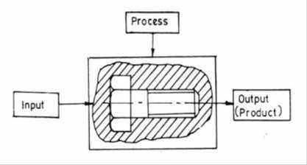
Metal Removal Processes
DEFINITION: A family of shaping operations, the common feature of which is removal of material from a starting work part so the remaining part has the desired geometry. The machines on which these operations are performed are called machine tools.
Variables in Processes of Metal Cutting:
▪
Machine tool selected to perform the processes
Cutting tool (geometry and material)
Properties and parameters of workpiece Cutting parameters (speed, feed, depth
of cut)
Workpiece holding devices (fixture or jigs)
▪
▪
▪
Fig. 1.0 Value addition by machining
▪
It is a value addition process by which raw materials of low utility and value due to its inadequate material properties and
poor or irregular size, shape and finish are converted into high utility and valued products with definite dimensions, forms and finish imparting some functional ability.
3

Slide 5
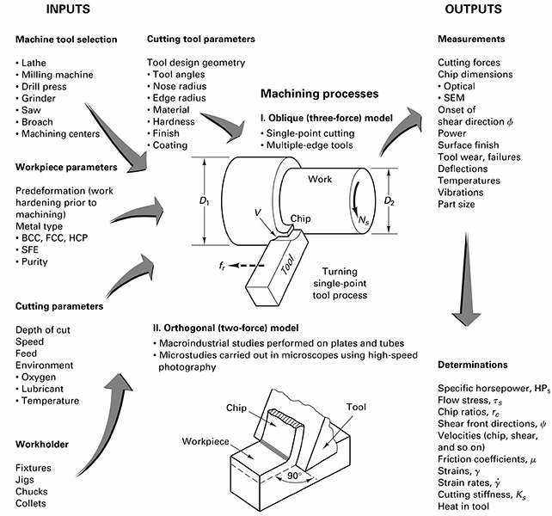
Inputs & Outputs
4

Slide 6
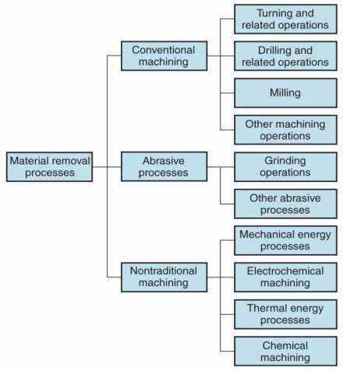
Classification
Traditional Process (Machining) – Material removal by a sharp cutting tool. e.g., turning, milling and drilling. The ‘‘other machining operations’’ in Figure
1.1 include shaping, planing, broaching, and sawing.
Abrasive processes – Material removal by
hard, abrasive particles, e.g., grinding. The ‘‘other abrasive processes’’ in Figure 1.1 include honing, lapping, and superfinishing. Nontraditional processes - Various energy forms other than sharp cutting
tool or abrasive materials to remove material generally by erosion. e.g., Laser and Electron Beam machining. The energy
forms include mechanical, electrochemical, thermal, and chemical
Figure 1.1: Classification of material removal processes
5

Slide 7
Metal Removal Processes
MAJOR CHARACTERISTICS OF CONVENTIONAL MACHINING
▪
▪
Generally macroscopic chip formation by shear deformation
Material removal takes place due to application of cutting forces – energy domain can be classified as mechanical
Cutting tool is harder than work piece at room temperature as well as under machining conditions
▪
ADVANTAGES OF MACHINING
▪
▪
▪
▪
Variety of work materials can be machined
Variety of part shapes and special geometric features possible Good dimensional accuracy
Good surface finish
DISADVANTAGES WITH MACHINING
▪
▪
Chips generated in machining are wasted material Time consuming process
8

Slide 8
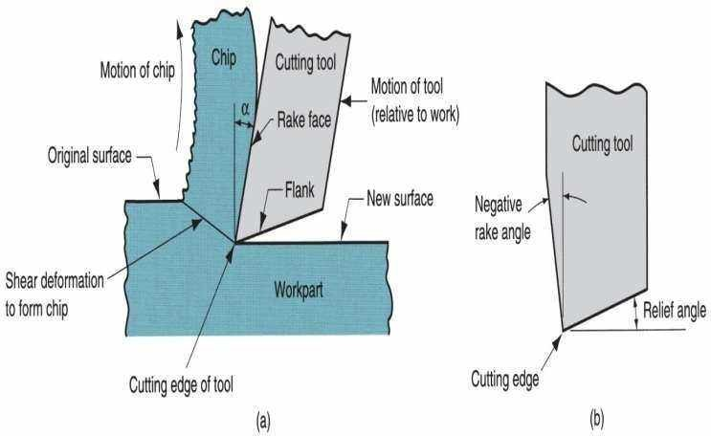
Basic Principle of Machining
Machining is a manufacturing process in which a sharp cutting tool is used to cut away material to leave the desired part shape. The predominant cutting action in machining involves shear deformation of the work material to form a chip; as the chip is removed, a new surface is exposed. Machining is most frequently applied to shape metals.
Figure 1.2: Machining process principle overview
8

Slide 9





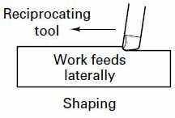

Machining Operations
Turning: Single point cutting tool removes material from a rotating workpiece to form a cylindrical shape Drilling: Used to create a round hole, usually by means of a rotating tool (drill bit) with two cutting edges Milling: Rotating multiple-cutting-edge tool is moved across work to cut a plane or straight surface.
Shaping and planning: Used to create flat surface
Broaching : Multi teeth tool used to make roughing and finishing in single stroke
Sawing: Used for cutoff operations
Figure 1.3: Seven basic machining processes in chip formation
8

Slide 10
Concept of Generatrix and Directrix
The machine tools, in general, provide two kinds of relative motions.
Primary Motion: It is the relative motion between the tool and work responsible
for the
cutting action is and absorbs most of the power required to perform the machining action. Secondary Motion: It is responsible for gradually feeding the uncut portion and may proceed in steps or continuously and absorbs only a fraction of the total power required for machining.
Depending upon the nature of two relative motions, various types of surfaces can be produced.
Generatrix: The line generated by the primary motion (cutting motion) is called the
generatrix.
Directrix: The line representing the secondary motion (feed motion) is called the directrix. It provides path to generatrix.
Depending upon the shapes of the generatrix and the directrix and their relative orientation various geometries can be produced on the workpiece.

Slide 11
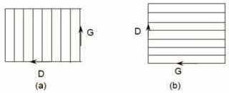
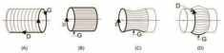
Concept of Generatrix and Directrix
GENERATION OF FLAT SURFACE
cutting motions as well as the feed motion are rectilinear but perpendicular to each other. Here the machined surface produced is a plane. The principle is shown in Fig. 1.4 where on a flat plain a straight line called Generatrix (G) is
traversed in a perpendicular direction called Directrix (D). This results in a flat surface.
Fig. 1.4 Generation of flat surfaces by
Generatrix and Directrix Fig. 1.5 Generation of cylindrical surfaces (of revolution)
GENERATION OF CYLINDRICAL SURFACES
The principles of production of various cylindrical surfaces (of revolution) are shown in Fig. 1.5, where, A long straight
cylindrical surface is obtained by a circle (G) being traversed in the direction (D) parallel to the axis as shown in Fig. 1.5(a)
A cylindrical surface of short length is obtained by traversing a straight line (G) along a circular path (D) as indicated in Fig. 1.5(b)
Form cylindrical surfaces by rotating a curved line (G) in a circular path (D) as indicated in Fig. 1.5 (c and d).

Slide 12
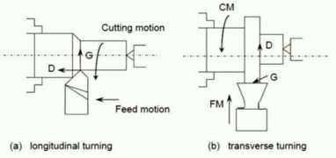
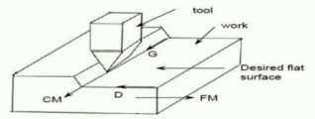
Concept of Generatrix and Directrix
TOOL – WORK MOTIONS
The lines representing the Generatrix and Directrix are usually produced by the locus of a point moving in two
Formative motions
❖
❖
Cutting motion (CM) : Primary Motion Feed motion (FM) : Secondary Motion
different directions and are actually obtained by the
Auxiliary motions
motions of the tool-tip (point) relative to the work surface.
❖
❖
❖
Indexing motion Additional feed motion Relieving motion
Hence, for machining flat or curved surfaces the machine tools need relative tool work
motions
Interconnections
Fig. 1.6 Principle of turning (cylindrical
surface)
Generatrix (G) – Cutting motion (CM) – Work (W) Directrix
(D) – Feed motion (FM) – Tool (T)
Fig. 1.7 Principle of producing flat surface in
shaping machine
Shaper
G – CM – T
D – FM – W
Planer
G – CM – Work D
– FM – Tool
11

Slide 13
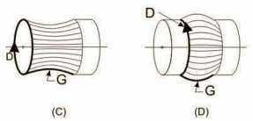
Concept of Generatrix and Directrix
The Generatrix and Directrix can be obtained in four ways:
Tracing (Tr) – where the continuous line is attained as a trace of path of a moving point
Forming (F) – where the Generatrix is simply the profile of the cutting edge
12

Slide 14
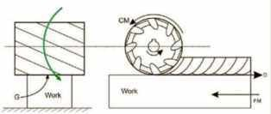
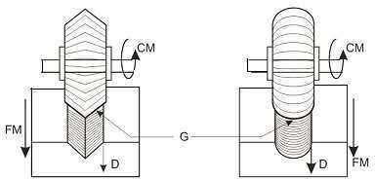
Concept of Generatrix and Directrix
Tangent Tracing (TTr) – where the Directrix is taken as the tangent to the series of paths traced by the cutting edges as indicated in Fig. 1.8
The G and D are connected here with the tool work motions as
G – x – T – F
D – FM – W – TTr
CM – T
Here G and D are independent of the cutting motion and the G is the line of contact between the milling cutter and the flat work surface. The present cutter being of roller shape, G has been a straight line and the surface produced has also been flat.
Form milling cutters will produce similar formed surfaces as shown in Fig. 1.9 where the ‘G’ is the tool-form.
Figure 1.8 Directrix formed by tangent tracing in plain milling
Fig. 1.9 Tool-work motions and G & D in form
milling
13

Slide 15
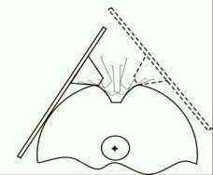
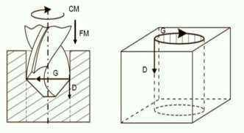
Concept of Generatrix and Directrix
Generation (G)
Here the G or D is obtained as an envelope being tangent to the instantaneous positions of a line or surface which is rolling on another surface. Gear teeth generation by hobbing or gear shaping is the example as can be seen in Fig. 1.10
Figure 1.10 Generatrix or directrix in gear teeth cutting by generation
For making holes in drilling machines both the
cutting motion and feed motion are the cutting tool i.e., the drill bit
imparted to whereas the
workpiece remains stationary. This is shown in Fig. 1.11. The G and D are linked with the tool- work in the way:
G-CM-T-Tr
D – FM – W –Tr
Figure 1.11 Tool Work Motions and G & D in
Drilling
14

Slide 16
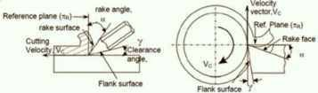
Concept of Rake & Clearance angles of cutting tools
The word tool geometry is basically referred to some specific angles or slope of the salient faces and edges of the tools at their cutting point. Rake angle and clearance angle are the most significant for all the cutting tools.
Fig. 1.12 Rake and clearance angles of cutting tools
Definition
Rake angle (α): Angle of inclination of rake surface from reference plane
Clearance angle (γ): Angle of inclination of clearance or flank surface
from the finished surface
15

Slide 17
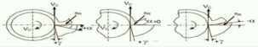
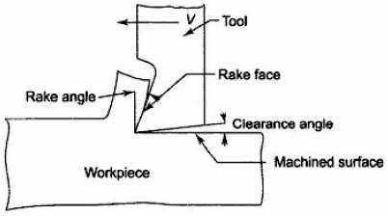
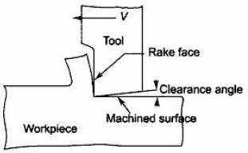
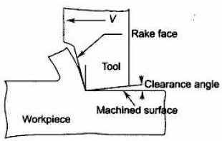
Rake Angles
Rake Angle: Rake angle is provided for ease of chip flow and overall machining. Rake angle may be positive, or negative or even zero as shown in Fig. 1.13.
(a) Positive rake
(b) zero rake rake
(c) negative
Fig. 1.13 Three possible types of rake angles

Slide 18
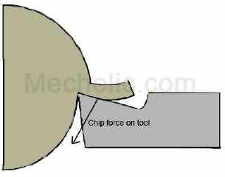
Rake Angles
Positive rake –A tool has a positive rake when the face of the tool slopes away from the cutting slants towards the back or side of the tool. In most cases, tools are provided with a positive rake
edges and
▪
Helps reduce cutting force requirement and thus cutting power requirement. (Imagine cutting by blunt knife v/s sharp knife)
▪
The force acting on tool tends to break tool tip or shear off the cutting edge of the tool.
Positive rake angle makes the tool sharp and pointed, but reduce the strength of cutting edge. (Very sharp pencil tip breaks)
It helps the formation of continues chip in ductile material and contributes to avoiding the formation of built-up edge chip.
▪
▪
Recommended for-
▪
▪
▪
▪
▪
▪
Low-strength/soft ferrous and non-ferrous metal Low power machine
Long shaft of small diameters (To avoid bending) Set up lacks strength
Low cutting speed
Cutting tool material is HSS.

Slide 19
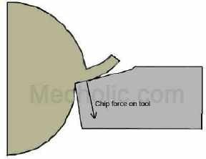
Rake Angles
Negative rake – A tool has a negative rake when the face of the tool slopes away from the slants upwards the back or side of the tool.
cutting edges and
▪
To increase edge-strength (mechanically and thermally) and life of the tool. More area helps in heat dissipation as well as provides strength.
Cutting tool with negative rake angle is stronger (blunt) , can take heavier depth of cut and used to cut high-strength material. Fig shows the force
acting on the tool. The force directed to the strongest part of the tool. Negative rake angle prevents adhesion.
Increase the surface finish.
Decreases tool wear and increases the tool life.
Higher cutting force during machining, this also increases the power consumption.
Increase vibration, friction and temperature at cutting edge.
▪
▪
▪
▪
▪
▪
Recommended for-
▪
▪
▪
▪
▪
Machining high strength alloy High speed cutting
With rigid setup to resist vibrations Cutting tools are ceramic and carbide
Tools are subjected to compressive forces

Slide 20
Zero Rake Angle & Clearance Angle
Zero rake – To simplify design and manufacture of the form tools.
▪
A neutral rake angle tool is simplest and easiest to manufacture, but it causes a massive crater wear when compared to other types. Neutral rake angle obstructs the movement of chip flow and causes build-up chip formation.
Examples-Gear cutting in milling machine, Thread cutting in lathe machine
▪
▪
Benefits: Increase tool strength, Avoids digging of tools into workpiece, Brass and CI are cut with zero rake.
Clearance Angle: Clearance angle is essentially provided to avoid rubbing of the tool (flank) with the machined surface which causes loss of energy and damages of both the tool and the job surface. Hence, clearance angle is a must and must be positive 3º ~ 15º depending upon tool-work materials and type of the machining operations like turning, drilling, boring etc.)

Slide 21
Cutting Parameters
Cutting Speed: Cutting speed is the distance traveled by the work surface in unit time with reference to the cutting edge of the tool. The cutting speed, v is simply referred to as speed and usually expressed in m/min.
Feed: The feed is the distance advanced by the tool into or along the workpiece each time
the tool point passes a certain position in its travel over the surface. In case of turning, feed is the distance that the tool advances in one revolution of the workpiece. Feed f is usually expressed in mm/rev. Sometimes it is also expressed in mm/min and is called feed rate.
Depth of cut: It is the distance through which the cutting tool is plunged into the workpiece surface. Thus it is the distance measured perpendicularly between the
machined surface and the unmachined (uncut) surface or the previously machined surface of the workpiece. The depth of cut d is expressed in mm. For Turning
DOC = 0.5(D₁ – D₂) = d

Slide 22
Classification of Cutting Tools
According to cutting edges
▪
Single point: e.g., turning tools, shaping, planning and slotting tools and boring tools
Double (two) point: e.g., drills
Multipoint (more than two): e.g., milling cutters, broaching tools, hobs, gear shaping cutters etc.
▪
▪
According to motion
▪
▪
▪
Linear motion tools – lathe tools, brooches
Rotary motion tools – milling cutters, grinding wheels Linear & rotary motion tools – drills, taps, etc.

Slide 23
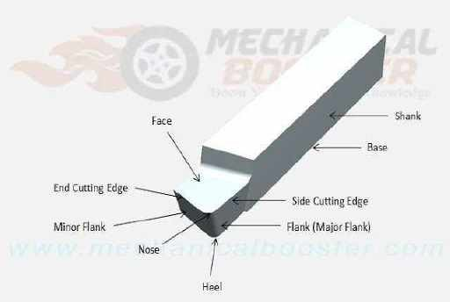
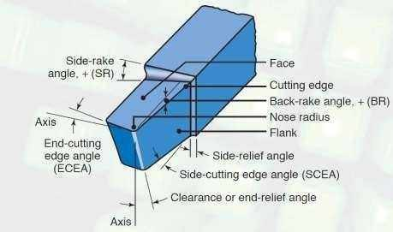
Geometry of Single Point Cutting Tool (Turning)
TOOL ELEMENTS
Fig. 1.14 Elements of Single Point Cutting Tool
Shank – It is main body of tool. It is the backward part of tool which is hold by tool post. The shank is gripped by tool holder.
Base –The bottom surface of tool is known as base. It is just opposite surface of face.
Heel – It is the intersection of the flank & base of the tool. It is curved portion at the bottom of the tool.
Nose or cutting point – It is the front point where side cutting edge & end cutting edge intersect.
Cutting edge – It is the edge on face of the tool which removes the material from workpiece. The cutting edges are side cutting edge (major cutting edge) & end cutting
edge ( minor cutting edge)
Noise radius –It is radius of the nose. Nose radius
Flank – Sometime flank is also known as cutting
face. It is the vertical surface adjacent to cutting
edge. According to cutting edge, there are two flank side flank and end flank. The major flank lies below and adjacent to the side cutting edge and the minor flank surface lies below and adjacent to the end
cutting edge.
Face – It is top surface of the tool along which the chips slides. It is the horizontal surface adjacent of cutting edges
increases the life of the tool and provides better surfa₂c₂e
finish. Too large a nose radius will induce chatter.

Slide 24
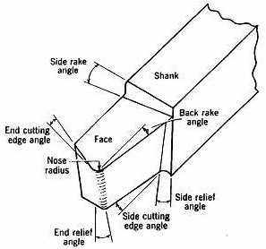
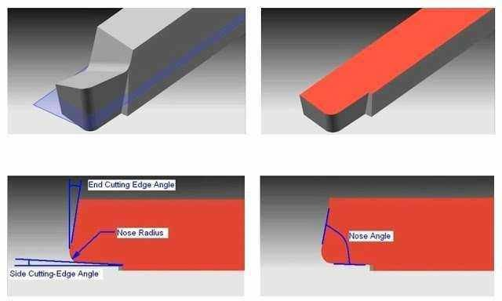
Geometry of Single Point Cutting Tool (Turning)
TOOL ANGLES
End Cutting Edge Angle: The angle formed in between the end cutting edge and a line perpendicular to the shank is called end cutting edge angle. It provides clearance between tool cutting edge and workpiece.
Side Cutting Edge Angle: The angle formed in
between the side cutting edge and a line parallel to the shank. It is responsible for turning the chip away from the finished surface.
Fig. 1.15 Figure explaining end cutting edge angle and side cutting edge angle
23

Slide 25
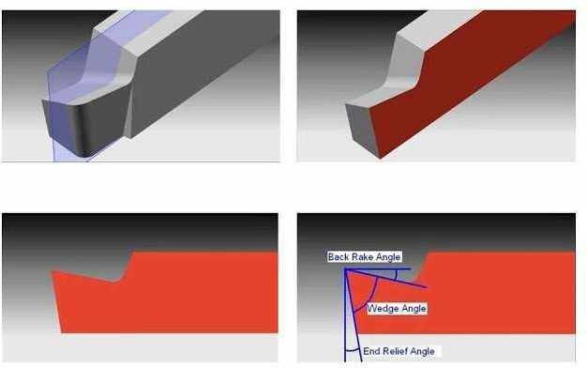
Geometry of Single Point Cutting Tool (Turning)
TOOL ANGLES
Back Rack Angle: The angle formed between the tool face and line parallel to the base is called back rake angle. Positive back rake angle takes the chips away from the machined surface, whereas negative back rake angle directs the chips on to the machined surface.
End Relief Angle: The angle formed between the minor flank and a line normal to the base of the tool is called end
relief angle. It is also known as front clearance angle. It avoids the rubbing of the workpiece against tool.
Lip Angle/ Wedge Angle: It is defined as the angle between face and minor flank of the single point cutting tool.
Fig. 1.16 Figure explaining Back rake angle, End relief angle and Wedge or lip angle
24

Slide 26
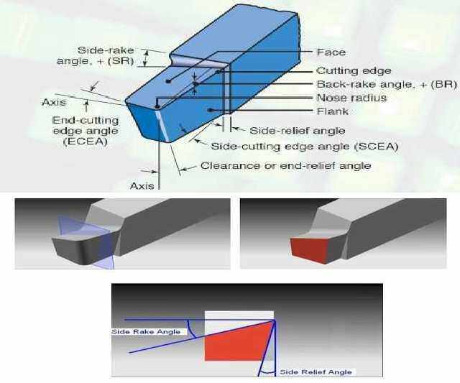
Geometry of Single Point Cutting Tool (Turning)
TOOL ANGLES
Side Rake Angle: the angle formed between the tool face and a line perpendicular to the shank is called side rake angle.
Side Relief Angle: the angle formed between the
major flank surface and plane normal to the base of the tool is called side relief angle. This angle avoids the rubbing between workpiece and flank when the tool is fed longitudinally.
Fig. 1.17 Figure explaining Side rake angle & Side relief angle
25

Slide 27
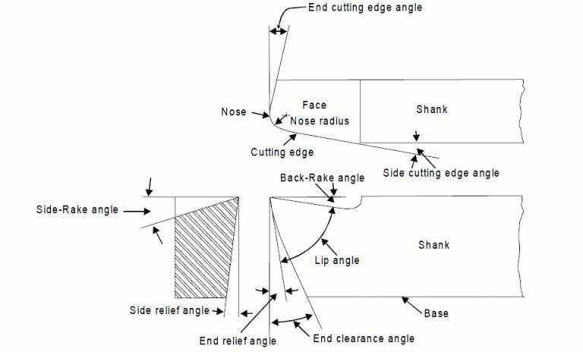
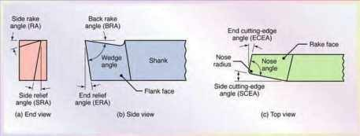
Tool Angles
Fig. 1.18 Figure explaining all angles & geometry of single point cutting tool
26

Slide 28
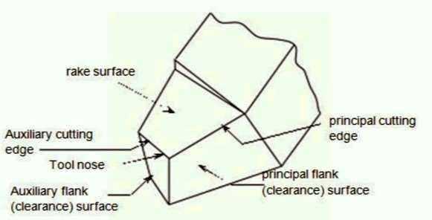
System of Description of Tool Geometry
Tool in Hand System: where only the salient features of the cutting tool point are identified or visualized as shown in Fig. 1.19. There is no quantitative information, i.e., value of the angles.
Fig. 1.19 Tool in Hand System

Slide 29
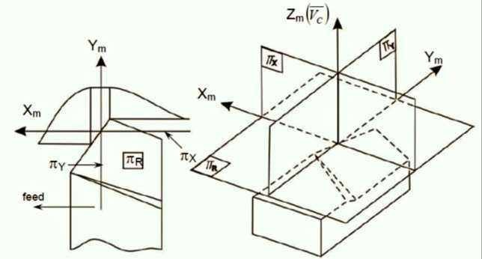
System of Description of Tool Geometry
Machine Reference System: This system is also called ASA system; ASA stands for American Standards Association. In this system angles of the tool face are defined in two orthogonal planes, parallel to the axis of the cutting tool & perpendicular to the axis of
cutting tool, both planes being perpendicular to the base of the tool.
π_{R} = Reference plane :
plane perpendicular to the velocity vector
π_{X} = Machine longitudinal plane : plane
perpendicular to π_{R} and taken in the direction of assumed longitudinal feed
π_{Y} = Machine Transverse plane: plane
perpendicular to both π_{R} and π_{X} taken in the direction of assumed cross feed
Axes: X_{m}, Y_{m} and Z_{m} in the direction of
longitudinal feed, cross feed and
Fig. 1.20 Planes and axes of reference in ASA system
cutting velocity (vector) respectively.

Slide 30
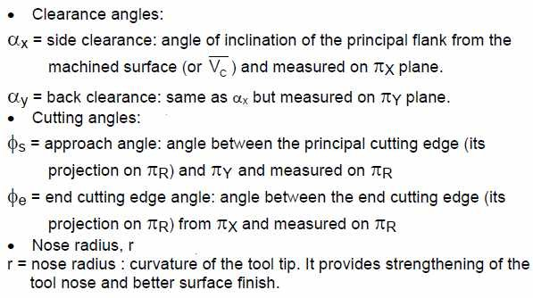
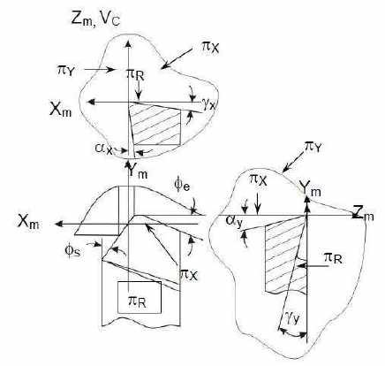

System of Description of Tool Geometry
Fig. 1.21 Tool Angles in ASA system
Tool Nomenclature in ASA System
The ASA system consists of seven elements to denote a single point cutting tool. They are always written in the following order. Back rake angle, Side rake angle, End relief angle, Side relief angle, End cutting edge angle, Side cutting edge angle, and nose radius.
For example, tool signature 0, 10, 6, 6, 10, 12, 1
means
Back rake angle = 0° Side rake angle = 10°
End relief angle = 6° Side relief angle = 6°
End cutting edge angle = 10° Side cutting edge angle = 12°
Nose radius = 1mm
29

Slide 31
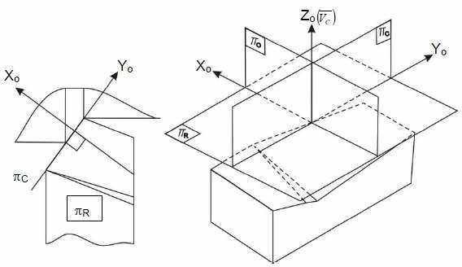
System of Description of Tool Geometry
Orthogonal Rake System (ORS)
This system is also known as ISO – old. The planes of reference and the co-ordinate axes used for expressing the tool angles in ORS are:
π_{R} - π_{C} - π_{O} and X_{o} - Y_{o} - Z_{o} which are taken in
respect of the tool configuration as indicated in Fig. 1.22
here,
π_{R} = Refernce plane perpendicular to the cutting
velocity vector, CV
π_{C} = cutting plane; plane perpendicular to π_{R} and
taken along the principal cutting edge
π_{O} = Orthogonal plane; plane perpendicular to
both π_{R} and π_{C} and the axes;
X_{o} = along the line of intersection of π_{R} and π_{O} Y_{o} = along the line of intersection of πR and πC
Z_{o} = along the velocity vector, i.e., normal to both
X_{o} and Y_{o} axes
Figure1.22: Planes and axis of reference in ORS

Slide 32
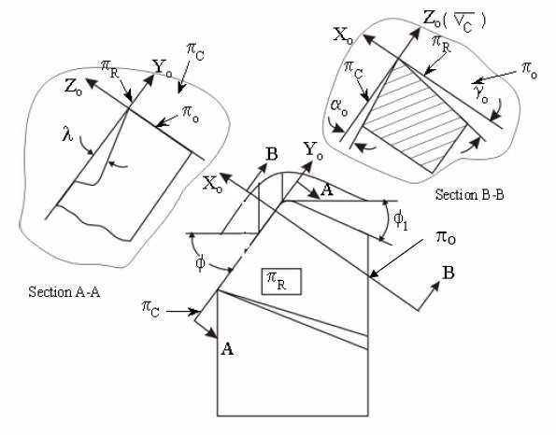
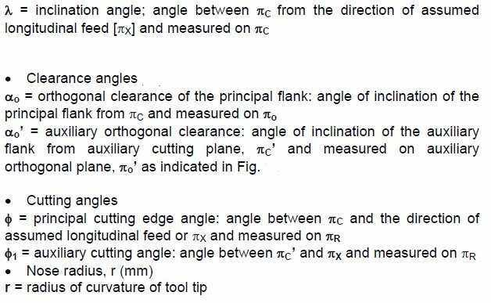
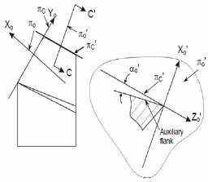
System of Description of Tool Geometry
Orthogonal Rake System (ORS)
Figure 1.23: Tool angles in ORS System
Figure1.24: Auxiliary Orthogonal Clearance Angle

Slide 33
System of Description of Tool Geometry
Tool Nomenclature in ORS System
The ORS system comprises seven parameters to describe a tool. The main elements of ORS designated in the following order-
Angle of inclination, Normal rake angle, Side relief angle, End relief angle, End cutting
edge angle, Approach angle and Nose radius. Example: Tool signature 5, 10, 6, 6, 5, 90, 1 Angle of inclination = 5°
Normal rake angle = 10° Side relief angle = 6° End relief
angle = 6°
End cutting edge angle = 5° Approach angle = 90°
Nose radius =1mm
32

Slide 34
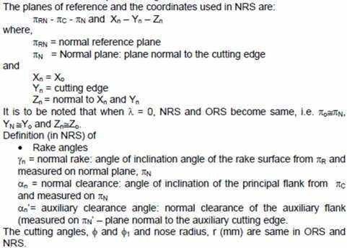
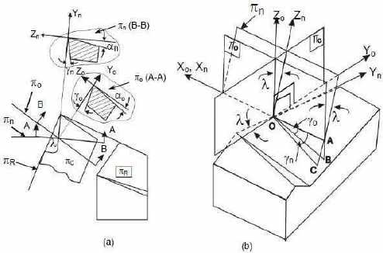
System of Description of Tool Geometry
Normal Rake System (NRS)
Thi s system is also known as ISO – new. ASA system has limited advantage and use like convenience of
inspection. But ORS is advantageously used for analysis and research in machining and tool performance. But ORS does not reveal the true picture of the tool geometry when the cutting edges are inclined from the reference plane, i.e., λ≠0. Besides, sharpening or resharpening, if necessary, of the tool by grinding in ORS requires some additional calculations for correction of angles. These two limitations of ORS are overcome by using NRS for description and use of tool geometry.
The basic difference between ORS and NRS is-
in ORS, rake and clearance angles are visualized in the orthogonal plane, π_{o}, whereas in NRS those angles are visualized in
another plane called Normal plane, π_{N}. The orthogonal plane, πo is simply normal to πR and πC irrespective of the inclination of the cutting edges, i.e., λ, but πN (and πN’ for auxiliary cutting edge) is always normal to the cutting edge. The differences between ORS and NRS have been depicted in Fig. 1.25.
Figure1.25: Differences of NRS from ORS w.r.t.
cutting tool geometry.
33

Slide 35
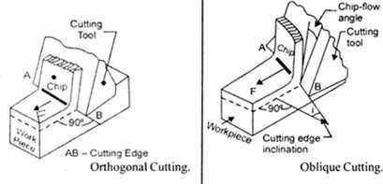
Orthogonal & Oblique Cutting
Orthogonal Cutting: In orthogonal cutting, the cutting edge inclination is zero and chip is expected to flow along the orthogonal plane. The cutting tool is presented to the workpiece in such a way that the cutting edge is normal to the tool feed direction. In orthogonal cutting, the radial force is zero, and it involves only two component of force; this simplifies the analysis of cutting motion.
Oblique Cutting: In oblique cutting, chip flow deviates from the orthogonal plane. Tool is presented to workpiece at an acute angle (θ < 90°) to the tool feed motion. The analysis of cutting include three mutually perpendicular component of force and it is being very difficult to analyse.
Figure1.26: Orthogonal and Oblique Cutting
34

Slide 36
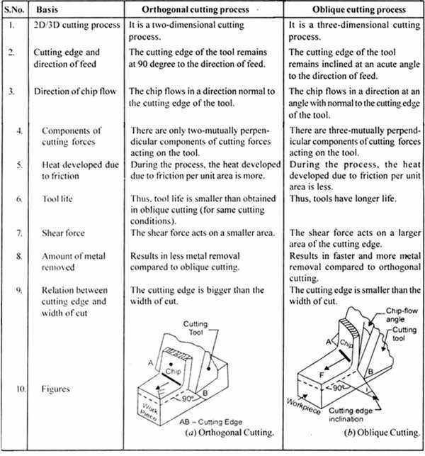
Comparison of Orthogonal & Oblique Cutting
3
5

Slide 37
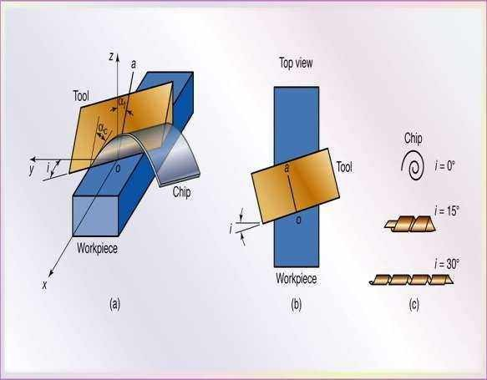
Orthogonal & Oblique Cutting
•
Chip in Fig. a flows up the rake face of the tool at
angle αc (chip flow angle), which is measured in the plane of the tool face.
Angle α_{n} , the normal rake angle, is a basic geometric property of the tool. This is
•
the angle between the normal oz to the workpiece surface and the line oa on the tool face.
•
The workpiece material approaches the tool at a velocity V and leaves the surface (as a chip) with a velocity Vc
Extra Figure (a) Schematic illustration of cutting with an oblique tool. Note the direction
of chip movement. (b) Top view, showing the inclination angle, i,. (c) Types of chips produced with tools at increasing inclination angles.
36

Slide 38
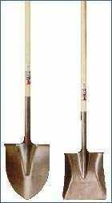

Orthogonal & Oblique Cutting
Effective rake angle α_{e} is
these
calculated in the plane of two velocities.
Assuming that the chip flow
the
angle αc is equal to
inclination angle i, the rake angle α_{e} is
effective
As i increases, the effective rake angle increases and the chip becomes thinner and longer.
Extra Figure (a) Schematic illustration of cutting with an oblique tool. Note the direction of chip movement.
(b) Top view, showing the inclination angle, i,. (c) Types of chips produced with tools at increasing inclination angles.

Slide 39
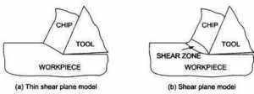
2 School of Thoughts
Thin Shear Plane Model: Deformation zone is very thin and planer. For analysis it is convenient but impossible to exist. If the transition from undeformed material to deformed material need to take place along a thin plane, then the acceleration across the plane has to be infinity for the velocity to change instantaneously from initial to cutting velocity. Similarly the stress gradient across the shear plane has to be very large to be practical.
Thick Shear Plane Model: Actual deformation zone is thick with a fan shape. Transition velocities and the shear stresses can be realistically accounted in this model.

Slide 40
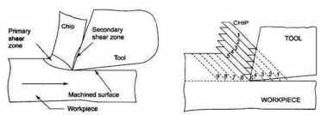
Chip Formation in Metal Cutting
Process: a wedge shaped single point cutting tool moves relative to the work piece. As the tool makes contact with the metal, it exerts pressure on it. Due to these compressive forces shear stresses are induced on the workpiece. Whenever and wherever the value of the shear stress reaches or exceeds the shear strength of that work material in the primary deformation region, yielding or slip takes place. This results in shear deformation in that region and in the plane of maximum shear stress. A chip is produced ahead of the cutting tool by first elastic deformation or yielding and then finally by plastic deformation and shearing the material continuously, along the shear plane AB. But the forces causing the shear stresses in the region of the chip quickly diminishes and finally disappears while that region moves along the tool rake surface towards the secondary shear zone and then goes beyond the point of chip-tool engagement. As a result the slip or shear stops propagating long before total separation takes place. In the meantime the succeeding portion of the chip starts undergoing compression followed by yielding and shear. This phenomenon repeats rapidly resulting in formation and removal of chips in thin layer by layer. This phenomenon has been explained in a simple way by Piispannen using a card analogy

Slide 41
Mechanics of in Metal Cutting
Model Used:
Orthogonal cutting 2D Model with certain assumptions is used to understand the mechanics of metal cutting. This avoids the complex analysis of 3D machining
Assumptions
✓
The tool tip is sharp and that the chip makes contact only with rake face of the tool. There is no contact along the clearance face.
The surface where shearing is occurring is a plane (Merchant). The deformation zone is very thin (in the order of 10-² to 10⁻³ mm) adjacent to the shear plane.
Merchant’s thin plane shear model considering the minimum energy principle is used. The model
is applicable at very high speeds.
The cutting edge is perpendicular to the cutting velocity
The chip does not flow to either side. The deformation is two dimensional, i.e., no side spread Uncut chip thickness is constant
Width of the tool is greater than the width of work.
Work moves with a uniform velocity
The stresses on the shear plane are uniformly distributed. Continuous chip without BUE
Workpiece material is rigid and perfectly plastic
Coefficient of friction is constant
The resultant force on the chip R' applied at the shear plane is equal, opposite and co-linear to the resultant force R applied to the chip at the chip-tool interface.
✓
✓
✓
✓
✓
✓
✓
✓
✓
✓
✓
✓

Slide 42
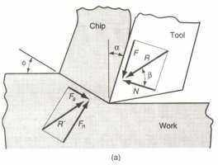
Forces in Metal Cutting
Knowledge of the cutting forces and power involved in machining operations is important for the following reasons:
▪
Machine tools can be properly designed to minimize distortion of the machine components, maintain the desired dimensional accuracy of the machined part, and help select appropriate tool holders and work- holding devices.
The workpiece is capable of withstanding these forces without excessive distortion.
Power requirements must be known in order to enable the selection of a machine tool with adequate
▪
▪
electric power.
Fs = Shear Force, which acts along the shear plane, is the resistance to shear of the metal in forming the chip.
F_{N} = Force acting normal to the shear plane, is the backing up force on the chip provided by the
work piece.
These two forces produce the resultant force, R’
F = Frictional resistance of the tool acting against the motion of the chip as it moves upward along the tool
N = Normal to the chip force, is provided by the tool.
These two forces produce the resultant force R. Forces acting on the chip must be in balance. Hence R' must be equal, opposite and collinear with R. Also F = R sin β & N=R cos β
Issue: F, N, F_{s}, and F_{n} cannot be directly measured. Forces that can be measured
using dynamometer are Cutting force F_{c} and Thrust force F_{t} which act on tool instead of chip.
Figure 1.28 (a) forces acting on the chip in orthogonal cutting
The ratio of F to N is the coefficient of friction, μ, at the tool- chip interface, and the angle β is the friction angle. Friction angle related to coefficient of friction as
Coeffiicie nt of friction,   tan   _{N}
F F  F tan
t c
F_{c}  F tan
t

Slide 43
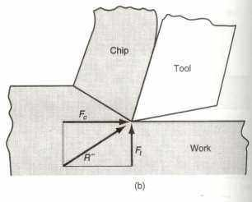
Forces in Metal Cutting
Cutting Force & Thrust Force
Forces acting on the tool that can be measured using various kind of dynamometers are the cutting force, F_{c}, acts in the direction of the cutting speed, v, and supply the energy required for the machining operation and the thrust force (feed force), F_{t}, acts in the direction normal to
cutting velocity, that is perpendicular to the workpiece. These two forces produce the resultant force, R’’ Equations can be derived easily by Merchant’s circle diagram to relate the forces that cannot be measured to the forces that can be measured:
F = F_{c} sin + F_{t} cos N =
F_{c} cos - F_{t} sin F_{s} = F_{c} cos - F_{t} sin F_{n} = F_{c} sin
+ F_{t} cos
Based on these calculated force, shear stress and coefficient of friction can be determined
Figure 1.29: Forces acting on the tool that can be measured
43

Slide 44
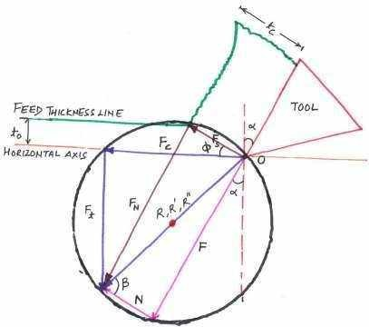
Construction of Merchant’s Circle
▪
Set up x-y axis labeled with forces, and the origin in
the center of the page. The cutting force (Fc) is drawn
horizontally, and the tangential force (Ft) is drawn vertically. (Draw in the resultant (R) of Fc and Ft.
▪
Locate the center of R, and draw a circle that encloses vector
R. If done correctly, the heads and tails of all 3 vectors will lie on this circle.
Draw in the cutting tool in the upper right hand quadrant,
taking care to draw the correct rake angle (α) from the vertical axis.
Extend the line that is the cutting face of the tool (at the same
▪
▪
rake angle) through the circle. This now gives the friction vector (F).
▪
A line can now be drawn from the head of the friction vector, to the head of the resultant vector (R). This gives the normal vector (N). Also add a friction angle (β) between vectors R and
N. Therefore, mathematically, R = Fc+Ft = F + N.
Draw a feed thickness line parallel to the horizontal axis. Next draw a chip thickness line parallel to the tool cutting face.
▪
▪
Draw a vector from the origin (tool point) towards the
intersection of the two chip lines, stopping at the circle. The
result will be a shear force vector (Fs). Also measure the shear force angle between Fs and Fc.
Finally add the shear force normal (Fn) from the head of Fs to the head of R.
Use a scale and protractor to measure off all distances (forces) and angles.
▪
▪
43

Slide 45
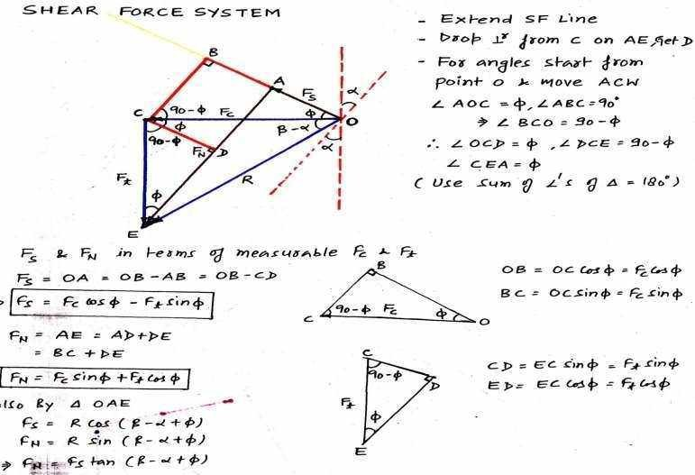
Force Relationships

Slide 46
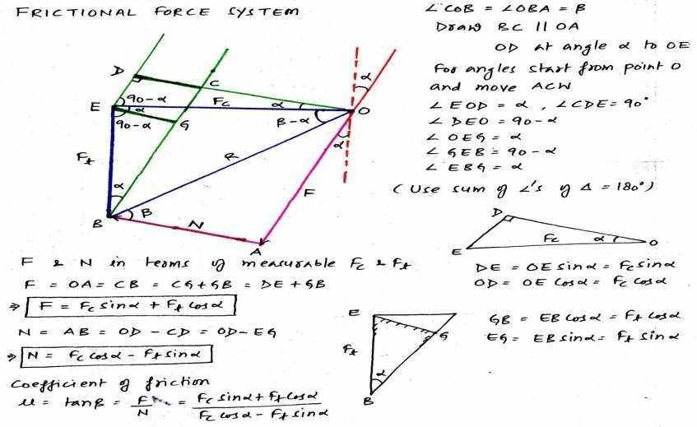
Force Relationships

Slide 47


Other Calculations
Figure 1.31: Mechanics of metal cutting

Slide 48


Other Calculations

Slide 49

Other Calculations
48

Slide 50


Chip Thickness Ratio/Cutting Ratio
Chip thickness ratio (r): The ratio of thickness of chip before cut (t_{o}) to the thickness of chip after cut (t_{c}) is known as chip thickness ratio.
Chip compression ratio (k): The reciprocal of r is known as chip compression ratio or chip reduction ratio (1/r). The chip reduction ratio is a measure of how thick the chip has become compared to the depth of cut (t₀). Thus the chip
reduction ratio is always greater than unity.

Slide 51
Chip Thickness Ratio/Cutting Ratio
Chip thickness ratio (r): The ratio of thickness of chip before cut (t_{o}) to the thickness of chip after cut (t_{c}) is known as chip thickness ratio.
Chip compression ratio (k): The reciprocal of r is known as chip compression ratio or chip reduction ratio (1/r). The chip reduction ratio is a measure of how thick the chip has become compared to the depth of cut (t₀). Thus the chip
reduction ratio is always greater than unity.

Slide 52




Other Methods of calculating Chip Thickness Ratio/Cutting Ratio
IN TERMS OF CHIP LENGTHS
IN TERMS OF VELOCITIES

Slide 53

CALCULATION OF SHEAR ANGLE (Φ)
This is the required relation to calculate the shear angle (φ). This relation shows that φ depends upon the t₀, tc, and α . It means by measuring t₀, t_{c} and α of the tool, shear
angle (φ) can be determined using above expression.

Slide 54


VELOCITIES IN METAL CUTTING PROCESS
Figure 1.32: Velocity relationships in Orthogonal Cutting Model
Cutting Speed or Velocity (V): Velocity of the cutting tool relative to the work piece.
Shear Velocity (V_{s}): It is the velocity of chip relative to the work piece. In other way, the velocity at which shearing
takes place.
Chip Velocity (V_{c}): It is the velocity of the chip up the tool face (rake face) during cutting.

Slide 55


SHEAR STRAIN & SHEAR STRAIN RATE
Figure: 1.33 (a)
Chip
as a plates
other, (b)
formation series of
depicted parallel
sliding relative to each
one of the plates isolated to show shear strain, and (c) shear strain triangle used to derive strain equation

Slide 56

Approximation of Turning by Orthogonal Model
Conversion Key: Turning operation vs Orthogonal Cutting
Feed f | Chip thickness before cut to
Depth d | Width of cut w or b
Cutting speed v | Cutting speed v
Cutting force Fc | Cutting force Fc
Feed Force F_{f} | Thrust Force F_{t}
Figure: 1.33 Approximation of turning by Orthogonal Turning (b) The corresponding Orthogonal Cutting
Model (a)

Slide 57

Various Theories of Metal Cutting
ERNST-MERCHANT’S THEORY & MODIFIED MERCHANT’S THEORY
5
6

Slide 58

Various Theories of Metal Cutting
Stabler Theory:
He modified the Ernst-Merchant equation as:
LEE AND SHAFFER’S THEORY
This theory analysis the process of orthogonal metal cutting by applying the plasticity for an ideal rigid plastic material.
Assumptions:
theory of
▪
The work piece material ahead of the cutting tool behaves like an ideal plastic material.
The behavior of the material is independent of rate of deformation The effects of temperature increase during deformation are negligible
The inertia effects resulting from acceleration of material during deformation are negligible.
The deformation of the metal occurs on a single shear plane.
There is a stress field within the produced chip which transmits the cutting force from the shear plane to the tool face and therefore, the chip does not get hardened.
The chip separates from the parent material at the shear plane.
Based on this, they developed a slip line field for stress zone, in which no
▪
▪
▪
▪
▪
▪
deformation would occur even if it is stressed to its yield point.
57

Slide 59



Various Theories of Metal Cutting
Stress-strain curve for a rigid plastic materia
l
Slip line field for orthogonal cutting
58

Slide 60

FRICTION IN METAL CUTTING
Amontons' laws of friction formulated in 1699 state that friction is independent of the apparent area of contact and proportional to the normal load between the two surfaces.
Coulomb’s laws of friction verified these laws and made a further observation: that the coefficient of friction is substantially independent of the speed of sliding.
Bowden and Tabor has contributed much to the explanation of these empirical laws. Microscopic examination shows that even the most carefully prepared "flat" metallic surfaces consist of numerous hills and valleys. When two surfaces are placed together, contact is established at the summits of only a few irregularities in each surface .If a normal load is applied, yielding occurs at the tips of the contacting asperities, and the real area of contact A_{r} increases until it is capable of supporting the applied load. For the vast majority of
engineering applications this real area of contact A_{r} is only a small fraction of the apparent contact area A_{a} and is given by

Slide 61



FRICTION IN METAL CUTTING
In the areas of real contact, the atoms of the two surfaces are brought within range of their very strong attractive forces, i.e. they are atomically bonded. The adhesion resulting from the intimate metallic contact of these asperities has been termed welding and when sliding takes place, a force is required for continual shearing of the welded junctions at the tips of these asperities. The total frictional force F_{f} is therefore given by
Equation above shows that the coefficient of friction is independent of the apparent contact area, and since the ratio would be expected to be constant for a given metal, the frictional force is proportional to the normal load (i.e., μ is constant). These results are consistent with the laws of dry sliding friction.

Slide 62
FRICTION IN METAL CUTTING
Issue: During metal cutting, it has generally been observed that the mean coefficient of friction between the chip and the tool can vary considerably and is affected by changes in cutting speed, rake angle, and so on.
Explanation: This variance of the mean coefficient of friction results from the very high normal pressures that exist at the chip-tool interface. For example, when steel is machined, these normal pressures can be as high as 3.5 GN/m² and can cause the real area of contact to approach or become equal to the apparent contact area over a portion of the chip-tool
interface (i.e., A,/Aa equals unity). Thus, under these circumstances A_{r} has maximum value and is constant.
The frictional force F_{f} is still given by
reached its
but it is no longer possible for the real contact area to increase proportionately to the load. Hence friction force is now independent of the normal force F_{n} and the ordinary
laws of friction no longer apply. Under these conditions the shearing action is no longer confined to surface asperities but takes place within the body of the softer metal.

Slide 63

CHIP-TOOL FRICTION MODEL
Consideration of frictional behavior in metal cutting has led to the model of orthogonal cutting with a continuous chip and no built-up edge shown in Fig. 1.38.
Sticking Region: Here the normal stresses between the chip and the tool are sufficiently high to cause Ar/Aa to approach unity over the region of length l_{st}, adjacent to the tool cutting edge,
termed the sticking region. In this zone shear stress constantly approaches the work material yield stress.
Sliding Region: In the length l_{f}-l_{st},
extending from the end of the sticking region to the point where the chip loses contact with the tool, the ratio Ar/Aa is less than unity, and therefore the coefficient of friction is constant; this region has been termed the sliding region.

Slide 64


Issue: Coefficient of friction increases with increase in rake angle.
It is normally expected that with an increase in the rake angle, the metal cutting forces decreases, and should normally be associated with a decrease in the friction. However in actual practice, the friction coefficient increases as shown in table below.
Explanation: This happens because the influence of the rake angle is not same on both components of cutting force. The normal force on the rake face decreases very fast compared to the friction force. Thus though there is an overall decrease in the forces, the coefficient is increasing. That is how Kronenberg calls this friction coefficient as apparent coefficient of friction.

Slide 65
Types of Chips-Introduction
Different types of chips are produced depending on the material machined and the cutting conditions. These conditions include:
being
Type of cutting tool used.
Speed and rate of cutting.
Tool geometry and cutting angles. Condition of machine.
Presence/Absence of cutting fluid, etc.
The study of chips produced are very important because the type of
•
•
•
•
•
chips produced influence the surface finish of the work piece, tool life, vibrations, chatter, force and power requirements, etc.

Slide 66


Chip Surfaces
Shiny Surface
It is the surface which is in contact with the rake face of the tool. Its shiny appearance is caused by the rubbing of the chip as it moves up the tool face.
Rough Surface
It is the surface which does not come into contact with any solid body and is
exposed to environment. It is the
original
Its jagged
surface of the work piece. rough appearance is
caused
by the
shearing action.

Slide 67
Types of Chips
Basically, there are four types of chips commonly observed in practice
Continuous chips
Continuous chips with edge
Serrated or segmented chips
Discontinuous
built-up

Slide 68

Continuous Chips
Continuous chips in the form of long coils having the same throughout usually are formed with ductile materials like
thickness mild steel,
copper, aluminum which can have large plastic deformation that are machined at high cutting speeds and/or high rake angles.
Figure: Continuous Chips

Slide 69



Continuous Chips
Shear zone types
Deformation of the material takes place along a narrow shear zone called primary shear zone. Figure (a)
Continuous chips may, because of high friction, develop a secondary shear zone at tool–chip interface (b).The secondary zone becomes thicker as tool–chip friction increases. Figure (b)
In CCs, deformation may also take place along a wide primary shear zone with curved boundaries. Figure (c). The lower boundary is below the machined surface, subjecting the machined surface to distortion, as depicted by the distorted vertical lines. This situation occurs particularly in machining soft metals at low speeds and low rake angles. It can produce poor surface finish and induce residual surface stresses.
Fig: (a) continuous chip with narrow, straight, and primary shear zone (b) continuous chip with secondary shear zone ₆₈
at the chip-tool interface (c) Wide primary shear zone with curved boundaries

Slide 70
Continuous Chips
Advantages:
Limitations
▪
Continuous chips are difficult to handle and dispose off.
Continuous chips remain in contact with the tool face for a longer period, resulting in more frictional heat.
Continuous chips coil in a helix and curl around the tool and work and even may injure operator if sudden break loose.
Particularly, in computer-controlled machined tools, because they tend to get tangled around the tool, and the operation has to stopped to clear away the chips.
That’s why Although CCs generally produce good surface
They generally produce good surface finish.
They are most desirable because the forces are
▪
•
stable and operation becomes vibration less.
They provide high cutting speeds.
▪
•
finish, not always desirable.
69

Slide 71

Continuous Chips
Use of Chip Breakers
Chip breaker is a piece of metal clamped to the rake
surface of the tool which bends the chip and breaks it
Chips can also be broken by
•
changing the tool geometry,
thereby controlling the chip flow
CBs increase the effective rake
•
angle of the consequently, shear angle.
tool and, the
increase
Fig (a) Schematic illustration of the action of a chip breaker .(b) Chip breaker clamped on the rake of a cutting tool. (c) Grooves in cutting tools acting as chip breakers Most cutting tools used now are inserts with built-in chip breaker features.
70

Slide 72
Continuous Chips
Responsible Factors
Machining more ductile aluminum.
materials such as copper,
High cutting speed with fine feed. Larger rake angle.
Sharper cutting edge. Efficient lubricant.
•
•
•
•
Tool material giving low friction between tool face and chips.
71

Slide 73


Continuous Chips with Built up Edge
•
Continuous chips with Built-Up Edge (BUE) are produced when machining ductile materials under following conditions:
High local temperature in cutting zone. Extreme pressure in cutting zone.
High friction at tool-chip interface.
The above machining conditions cause the work material to adhere or stick or weld to the cutting edge of the tool and form Built-Up Edge (BUE).
•
•
•
•
Figure: Built Up Edge Type Chips
72

Slide 74
Continuous Chips with Built up Edge
•
As it becomes larger, BUE becomes unstable and eventually breaks up.
Part of BUE material is carried away by the tool side of the chip; the rest is randomly on the workpiece surface.
•
deposited
•
The process of BUE formation and destruction is repeated continuously during the cutting operation, unless measures are taken to eliminate it. This cycle is source of vibration and poor surface finish.
•
In effect, a built-up edge changes the geometry of the cutting edge and dulls it
Because of work hardening and deposition of successive layers of material. BUE hardness increases significantly .
•
•
The built-up edge generates localized heat and friction, resulting in poor finish, power loss.
The built-up edge is commonly observed in practice
surface
•
73

Slide 75
Continuous Chips with Built up Edge
Advantages:
Although built-up edge is generally undesirable, a thin, stable BUE is usually desirable because it reduces wear by protecting the rake face of the tool.
Responsible Factors:
•
•
•
•
•
Low cutting speed. Low rake angle.
High feed.
Inadequate supply of coolant. Higher affinity (tendency to form bond) of tool material and work material.
Limitations:
Reduction or Elimination of BUE:
This is a chip to be avoided.
The phenomenon results in a poor surface finish
High power consumption
Fluctuation in cutting force induces vibration that causes tool failure. Also abrasion on the
tool flank due to the hard fragments of BUE escaping away causes it.
•
•
•
•
•
•
•
Increasing the cutting speed. Increasing the rake angle.
Decreasing the depth of cut. Using an effective cutting fluid. Using a sharp tool.
Light cuts at higher speeds. Use a cutting tool that has lower chemical affinity for the
workpiece material (Like ceramic cutting tools)
•
•
74

Slide 76

Serrated Chips
•
Serrated segmented
chips (also called or nonhomogeneous
chips, are semi continuous chips with large zones of low shear strain and small zones of high shear strain, hence the latter zone is called shear localization.
Metals with
low thermal
conductivity decreases temperature
and strength
that
with
sharply
(thermal softening)
exhibit this behavior, most notably titanium.
Figure: Serrated chips
•
The chips have a saw tooth- like appearance.

Slide 77


Discontinuous Chips
Discontinuous chips are produced when machining more brittle materials such as grey cast iron, bronze, brass, etc. with small rake angles. These materials lack the ductility necessary for appreciable plastic chips deformation. The material fails in a brittle fracture ahead of the tool edge along the shear zone. This results in small segments of discontinuous chips.
Figure: Discontinuous Chips

Slide 78
Discontinuous Chips
Advantages:
Since the chips break-up into small segments, the friction between the tool and the chip
Responsible Factors:
Machining because
brittle they do
materials
reduces, resulting in better surface finish. These chips are convenient to collect, handle and dispose of.
Limitations:
have
^{n}caºp^{t} acity to undergo the hi^{t}g^{he} shear strains involved in cutting.
Very low or very high cutting speeds
•
•
Because of the discontinuous nature of chip formation, forces continuously vary during cutting process.
More rigidity or stiffness of the cutting tool, holder, and work holding device is required due to varying cutting forces.
Consequently, if the stiffness is not enough, the machine tool may begin to vibrate and
Materials inclusions structures
that contain
hard or have graphite
and impurities
such as the
•
flakes in gray cast iron. Large depths of cut.
Low rake angles.
Lack of an effective cutting fluid.
Low stiffness of the toolholder or the
machine tool, thus allowing vibration and chatter to occur.
•
•
•
•
•
chatter. This, in turn, adversely affects the
surface finish and accuracy of the component. It may damage the cutting tool or cause excessive wear.
77

Slide 79

Cutting Temperatures-Introduction
As in all metalworking processes where plastic deformation is involved, approx. 98% of the energy dissipated in cutting is converted into heat that, in turn, raises the temperature in the cutting zone. The remaining energy (about 2%) is retained as elastic energy in the chip.
On tool
Excessive temperatures lower the strength, hardness, stiffness and wear resistance of the cutting tool; Cutting edges plastically deform; thus, tool shape is altered.
Main sources of heat in machining are:
1. The work done in shearing
in
the primary shear zone
2. Energy dissipated as friction at the tool-chip interface
Rapid tool wear , which reduces tool life
Thermal flaking and fracturing of cutting edges may take place thermal shock
Built up edge formation
On work
3. Heat generated by friction rubbing, especially for dull or worn tools.
due to
Determination of
Analytically – using mathematical models
Cutting
Temperature
Uneven dimensional changes in the part being machined, making it difficult to control its dimensional accuracy and tolerances.(thermal distortion)
(equations) if available or can be developed. This method is simple, quick and inexpensive but less accurate and precise.
Experimentally – this method is more accurate, precise and reliable
Thermal damage and metallurgical changes in the machined adversely affecting its properties.
Surface damage by oxidation, rapid corrosion, burning etc.
surface,
78

Slide 80
Analytical Determination
The mean temperature
for the orthogonal
cutting is
dimensional
derived by
analysis using
Nathan Cook from
0.333
experimental data for
T

0.4U vt_{o} 
various work materials
C K 

where T = temperature rise at tool-chip interface; U = specific energy; v = cutting speed; t_{o} = chip thickness before cut;
C = volumetric specific heat of work material; K = thermal diffusivity of work material. By this formula-
Cutting temperatures increase with: Cutting temperatures decrease with:
•
•
•
strength of the workpiece material cutting speed
depth of cut
increasing specific heat
increasing thermal conductivity of workpiece material
Tool material | a | b
Carbide | 0.2 | 0.125
HSS | 0.5 | 0.375
The mean temperature in turning on a lathe is proportional to the cutting speed and feed:
Mean temperature α Vª f^{b}
a and b are constants that depend on tool and workpiece materials, V is the cutting speed, and f is the feed of the tool.
79

Slide 81



Temperature Distribution
Figure Typical temperature distribution in the cutting zone. Note the severe temperature gradients within the tool and the chip, and that the workpiece is relatively cool.
Figure Temperatures developed in turning 52100 steel: (a) flank temperature distribution and (b) tool-ship interface temperature distribution.
Particular temperature pattern depends on several factors pertaining to material properties and cutting conditions, including the type of cutting fluid (if any) used during machining
▪
As speed increases, the time for heat dissipation decreases and temperature rises. Dark-bluish color of the chips (caused by oxidation) produced (rub your hands together faster).
The chip carries away most of the heat generated. As speed increases, a larger proportion of the total heat generated is carried away by the chip, and less heat goes into the workpiece or the tool. (High speed machining has evolved).
The other main benefit is associated with the favorable economics in reducing machining time.
▪
Figure Proportion of the heat generated in cutting transferred into the tool, workpiece, and chip as a function of the cutting speed. Note that the chip removes most of the heat.
▪

Slide 82
Experimental Determination/ Measurement of temperature at chip-tool interface
▪
Calorimetric method – quite simple and low cost but inaccurate and gives only grand average value
▪
Decolorizing agent – some paint or tape, which change
in color with variation of temperature, is pasted on the tool or job near the cutting point; the as such color of the chip
(steels) may also often indicate cutting temperature
Tool-work thermocouple – simple and inexpensive but gives only average or maximum value
Moving thermocouple technique Embedded thermocouple technique Photo-cell technique
Infra ray detection method
▪
▪
▪
▪
▪

Slide 83

Tool Work Thermo Couple Technique
In a thermocouple two dissimilar but electrically conductive metals are connected at two junctions. When one of the junctions is heated, the difference in temperatures at the hot and cold junctions produces a proportional current. This current is detected and measured by a milli- voltmeter. In machining like turning, the tool and the job constitute the two dissimilar metals and the cutting zone functions as the hot junction. Then the average cutting temperature is evaluated from the mV after thorough calibration for establishing the exact relation between mV and the cutting temperature
Figure: Tool-work thermocouple technique of measuring cutting temperature

Slide 84

Moving Thermo Couple Technique
This simple method, schematically shown in Figure enables measure the gradual variation in the temperature of the flowing chip before, during and immediately after its formation. A bead of standard thermocouple like chrome-alumel is brazed on the side surface of the layer to be removed from the work surface and the temperature is attained in terms of mV
Figure: Moving thermocouple technique

Slide 85

Embedded Thermo Couple Technique
In operations like milling, grinding etc. where the previous methods are not applicable, embedded thermocouple can serve the purpose. Figure shows the principle. The standard thermocouple monitors the job temperature at a certain depth, h_{i} from the cutting zone. The temperature recorded in oscilloscope or strip chart recorder becomes maximum when the thermocouple bead comes nearest (slightly offset) to the grinding zone. With the progress of grinding the depth, hi gradually decreases after each grinding pass and the value of temperature, θm also rises as has been indicated in Figure. For getting the temperature exactly at the surface i.e., grinding zone, hi has to be zero, which is not possible. So the θm vs hi curve has to be extrapolated upto hi = 0 to get the actual grinding zone temperature. Log – log plot helps such
extrapolation more easily and accurately.
Figure Embedded thermocouple technique

Slide 86

Embedded /Measurement of chip tool interface temperature by compound tool
In this method a conducting tool piece (carbide) is embedded in a non- conducting tool (ceramic). The conducting piece and the job form the tool-work thermocouple as shown in Figure which detects temperature θi at the location (Li) of the carbide strip. Thus θi can be measured along the entire chip-tool contact length by gradually reducing Li by grinding the tool flank. Before that calibration has to be done as usual.
Figure: Compound rake used for measuring cutting temperature along rake surface

Slide 87

Photo Cell Technique
This unique technique enables accurate measurement of the temperature along the shear zone and tool flank . The electrical resistance of the cell, like PbS cell, changes when it is exposed to any heat radiation. The amount of change in the resistance depends upon the temperature of the heat radiating source and is measured in terms of voltage, which is calibrated with the source temperature. It is evident that the cell starts receiving radiation through the small hole only when it enters the shear zone where the hole at the upper end faces a hot surface. Receiving radiation and measurement of temperature continues until the hole passes through the entire shear zone and then the tool flank.
Figure Measuring temperature at shear plane and tool flank by photocell technique

Slide 88

Infra-red photographic Technique
This modern
and powerful
method is based on taking infra-red photograph of the hot surfaces of the tool, chip and job and get temperature distribution at those surfaces.
Proper calibration
is to be done before that. This
way the temperature can be recorded as
profiles indicated pattern
in Fig. readily change
The fringe
changes with
the
in any machining which affects
parameter
cutting temperature.
Figure: temperature distribution at the tool top detected by infra ray technique

Slide 89

Numericals
89

Slide 90

Numerical
89

Slide 91

Numericals
90

